Slide 1
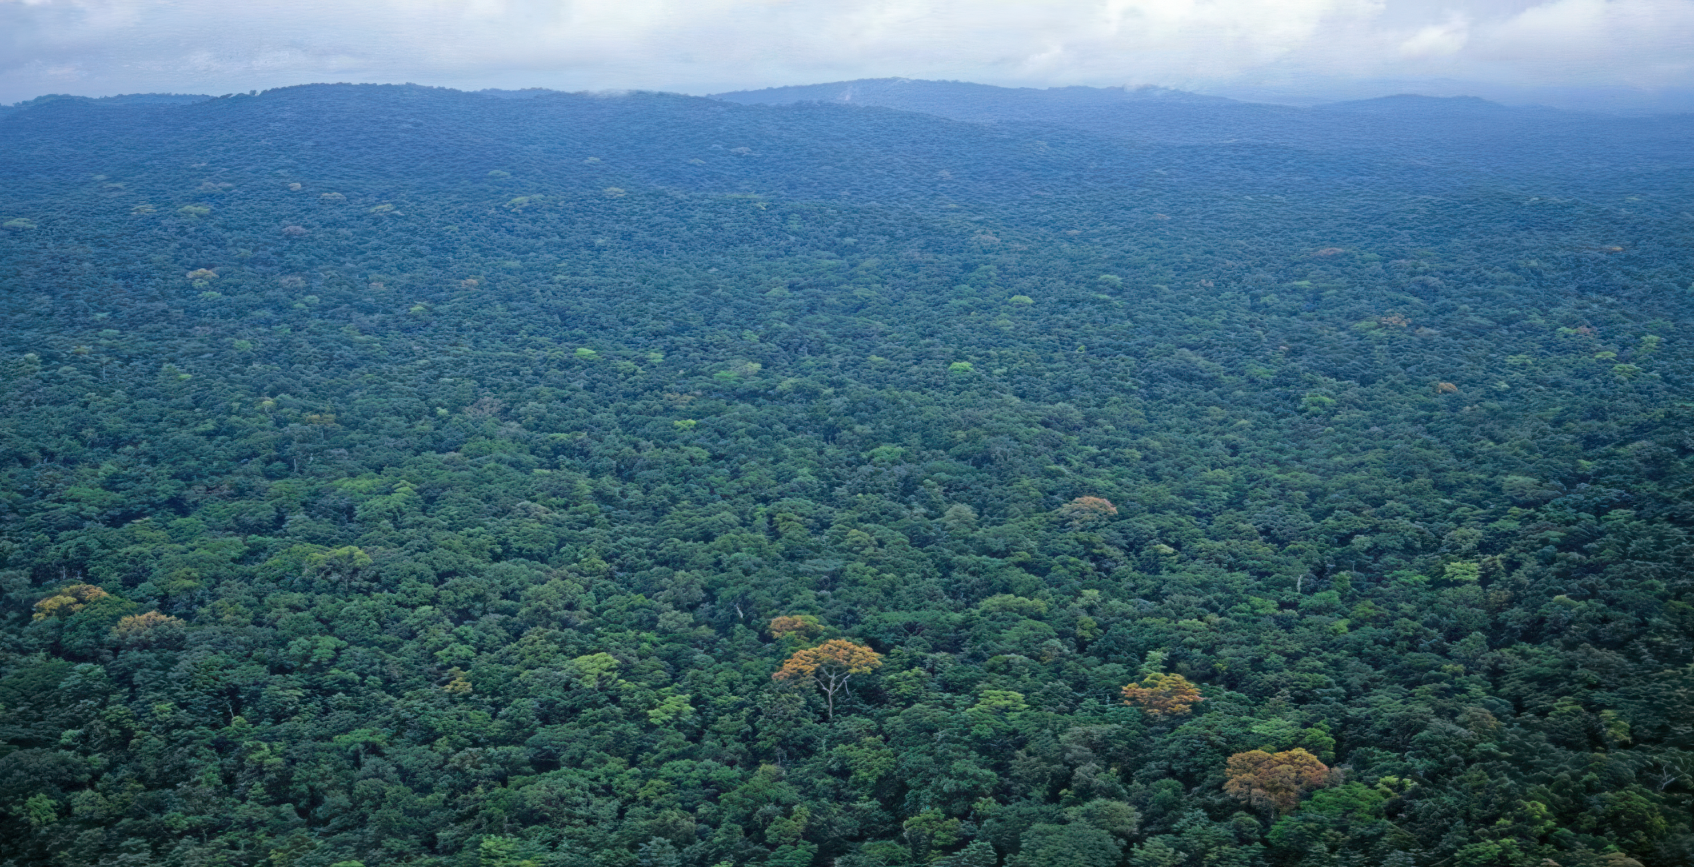
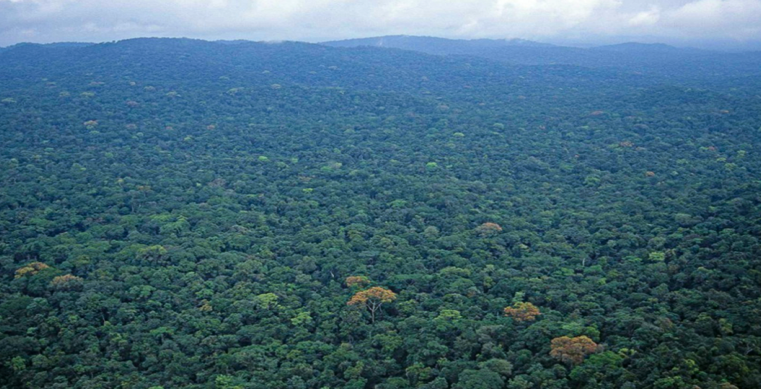
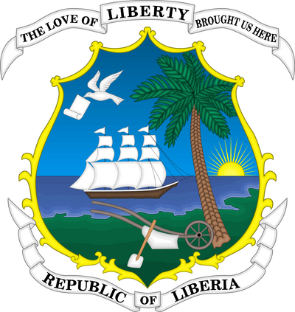

FORESTRY DEVELOPMENT AUTHORITY (FDA)
MINING AND ITS IMPLICATIONS FOR SUSTAINABLE
FOREST MANAGEMENT IN LIBERIA
National Forest Forum, 2025
Silas Kpanan Ayoung Siakor
Director, IDL
November 3-5, 2025

Slide 2
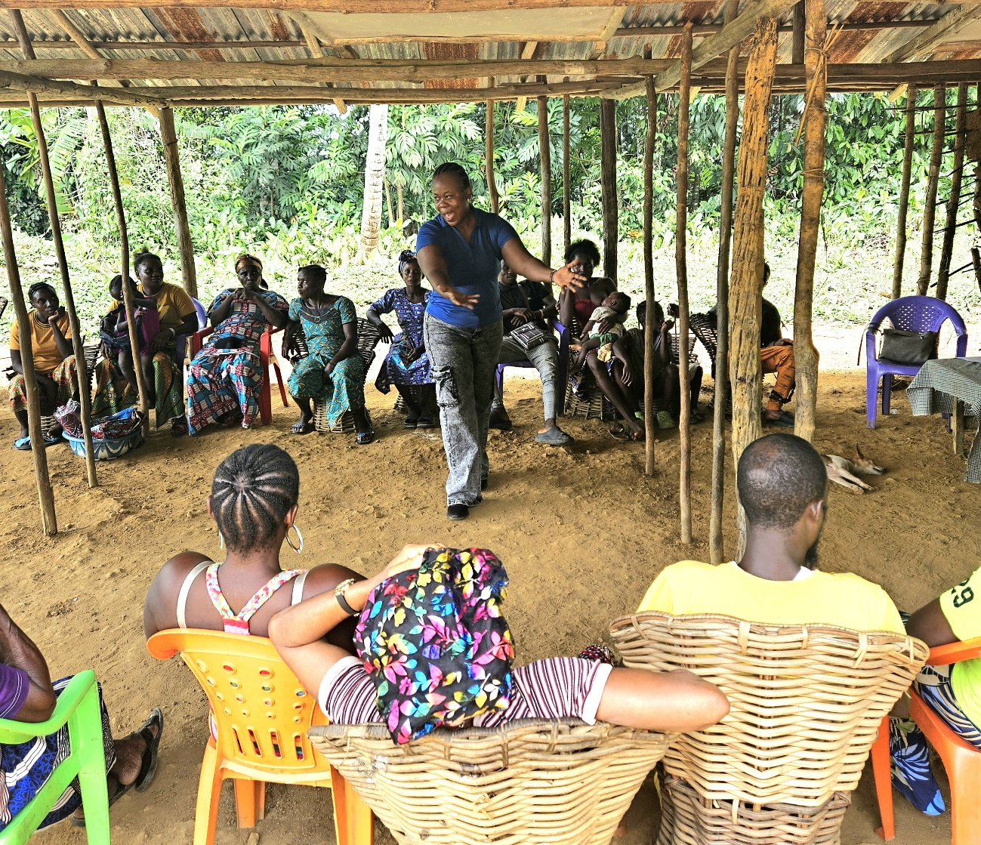
OUR STARTING POINT
Mining is the cornerstone of the Liberian economy. In 2022, formal mining constituted almost all exports, more than half of the value of goods & services (GDP), and 17 percent of all government revenue.
This is neither new nor news. In the 1980s, Liberia was Africa's largest iron ore producer.

Slide 3
Mining drives the Liberian economy
Industrial sector: 2022

Slide 4
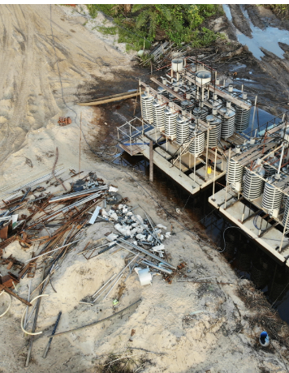
Despite its economic benefits, mining is…
Having significant negative impacts on the environment, forests and biodiversity.
It is damaging Protected Areas, Proposed Protected Areas, and Authorized Community Forests.
Conflicting with other land uses including (FMCs) and community land rights.

Slide 5
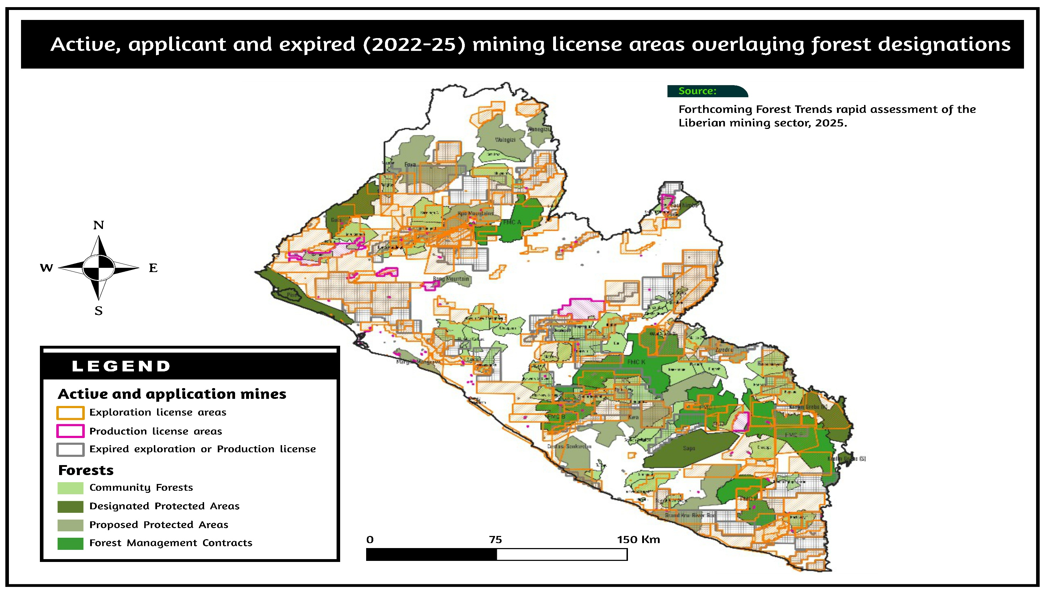
HERE YOU HAVE FOUR IDEAS

Slide 6
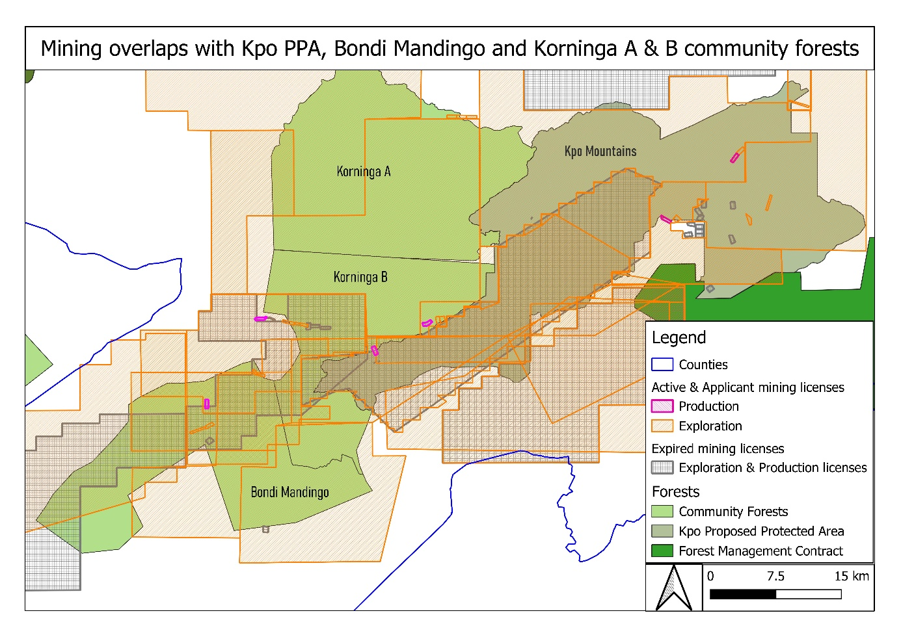

Slide 7
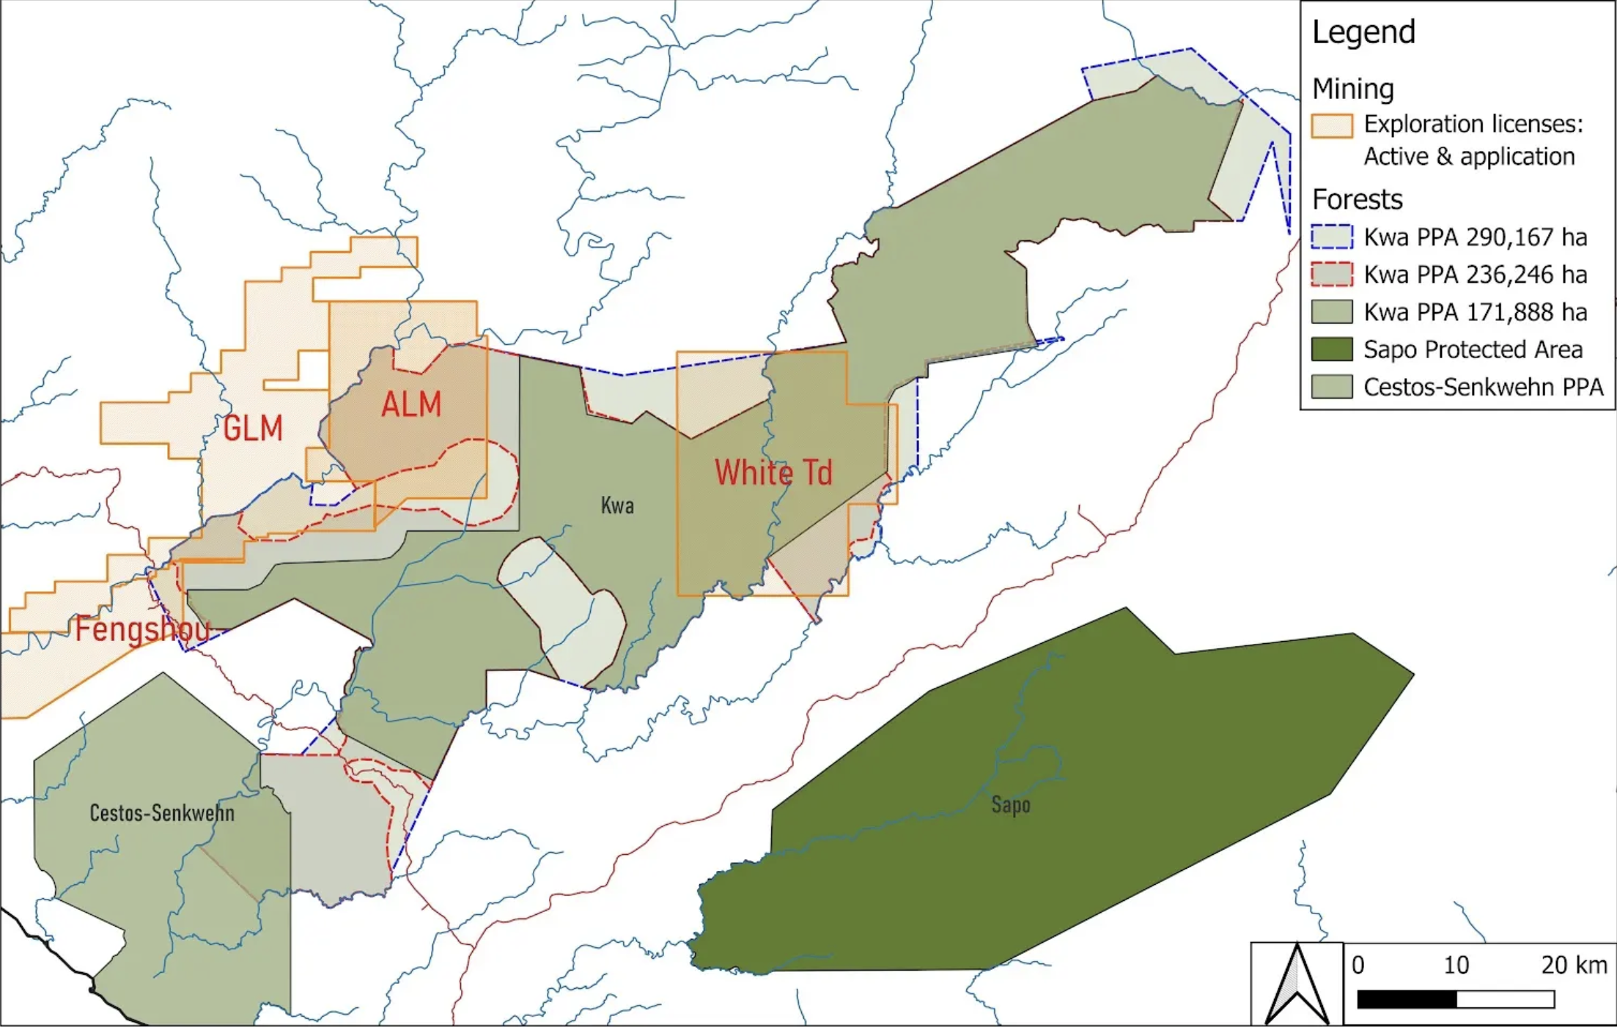
Kwa Proposed Protected Area
mining

Slide 8
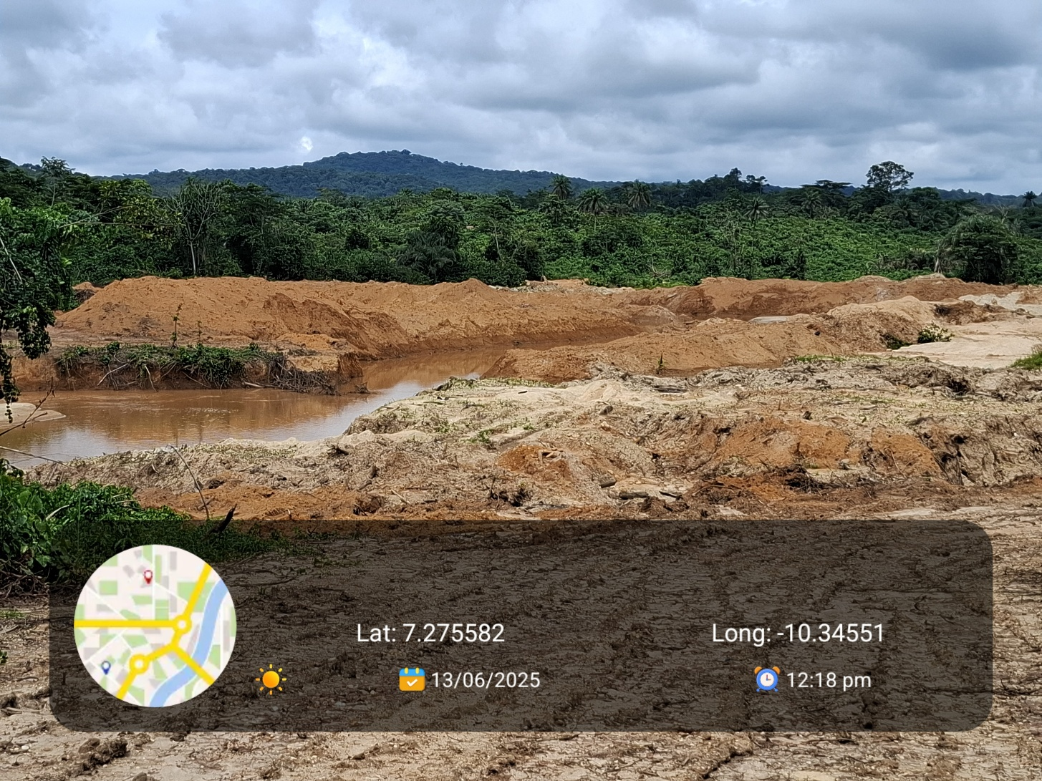
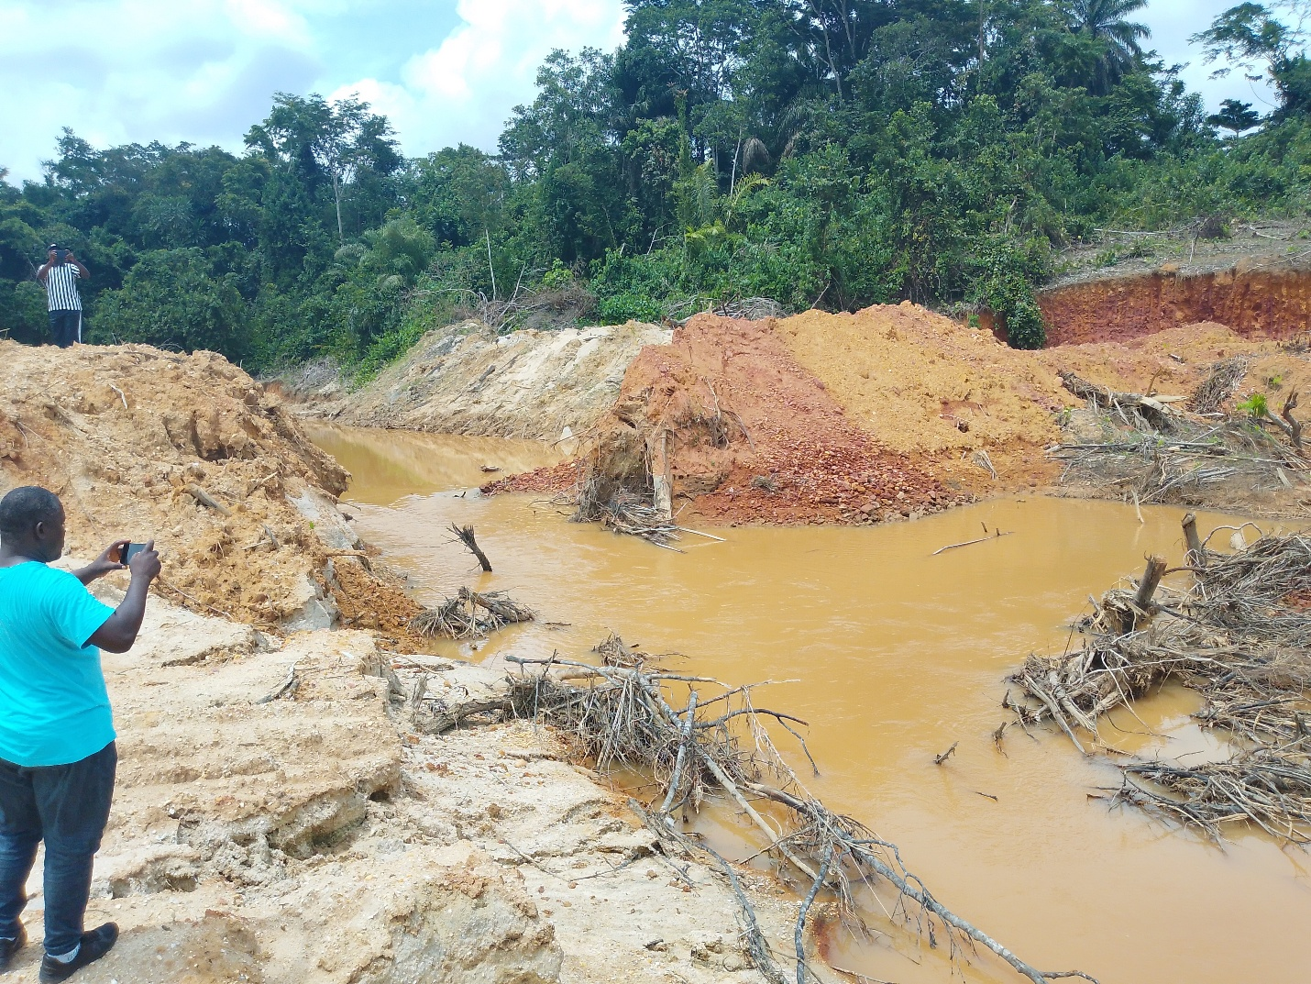
The overlaps do not take into account artisanal mining, which have reached alarming proportions.

Slide 9
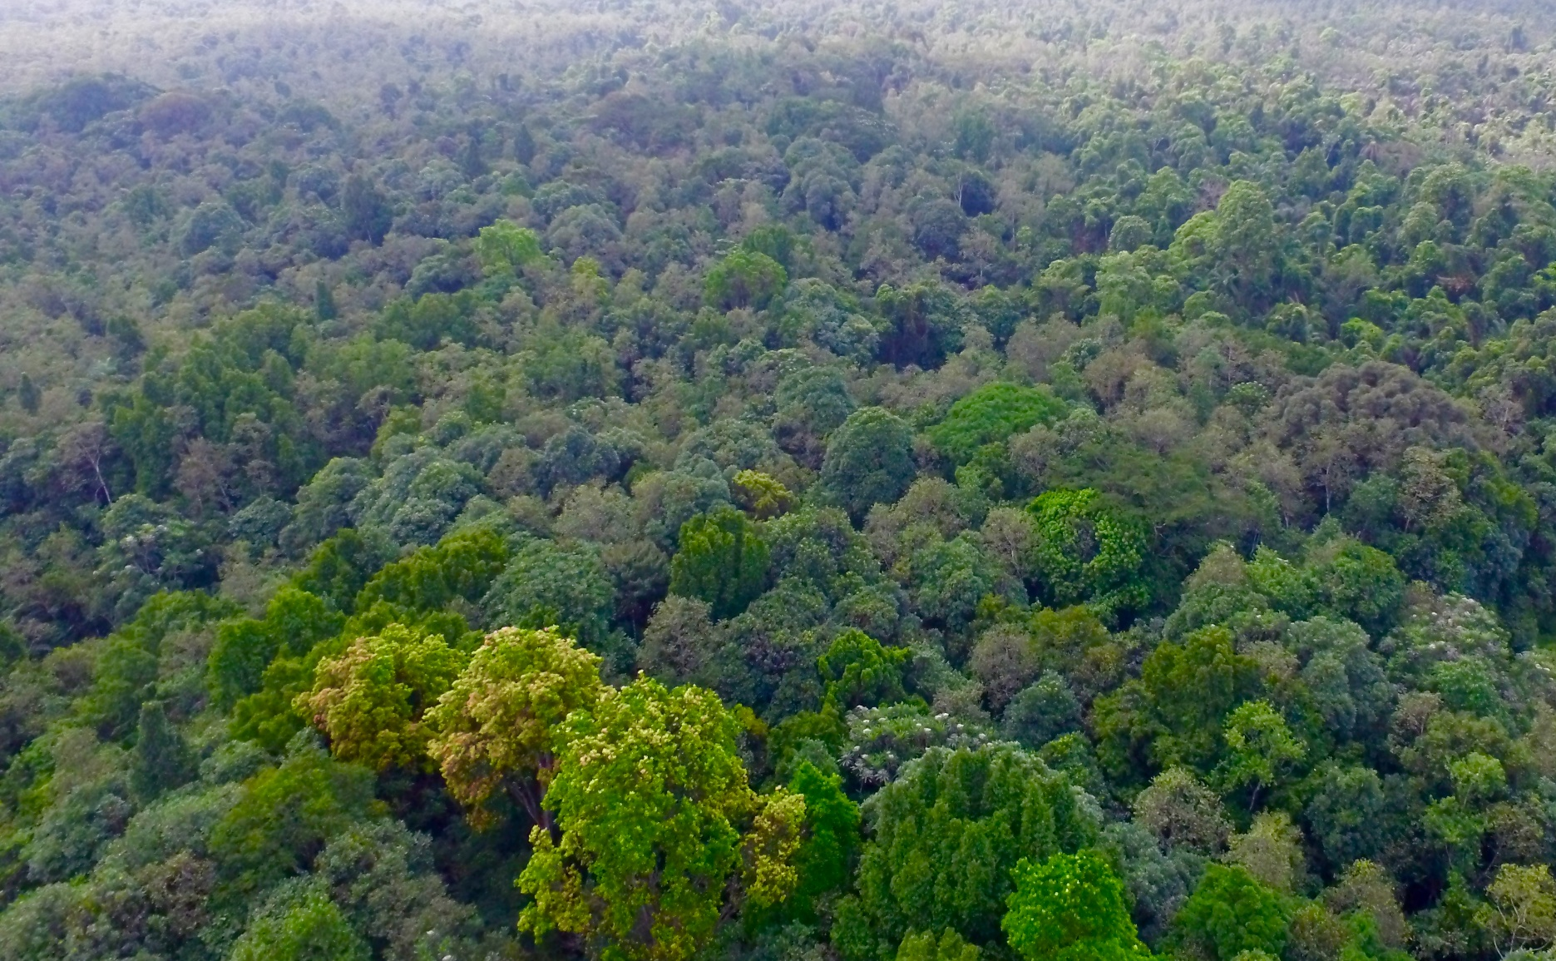
Good news!
We still have more forests than all our neighbors.
BUT…
We need to act urgently and decisively to better manage what we have.

Slide 10
RECOMMENDATIONS TO CONSIDER
Inter-agency coordination and collaboration need to be strengthened.
Starting with coherence in policies, laws, and practices.
Establish a framework for land use planning and develop a high-level land use plan that forms the basis for future decision-making regarding land-based concession and other land uses.
Given the bundle of rights communities now have, elevate them to partners in development, not just beneficiaries.
A foundation for sustainable forest management

Slide 11
For more information
Website: www.idlliberia.org
Email: info@idlliberia.org
Email: s.siakor@idlliberia.org
+231 (0)555994645
+231 (0)774499590
THANK YOU!

